Slide 1
Financial Literacy Test Review

Slide 2
Standard 1 Decision Making& Goals
Standard 2 Income and Careers
Standard 4 Savings, Investing and Retirement Planning
Standard 5 Consumer Safeguards and Risk Management
Standard 3 Money Management

Slide 3
Decision Making

Slide 4
The Decision-Making Process
Identify the problem
Gather information and list possible alternatives
Consider consequences of each alternative
Select the best course of action
Evaluate the results

Slide 5
Factors that can
Influence a Decision
Values
  What is important to your family, others in your culture?
B. Peers
  People you know
  Pressure for positive or negative behaviors
C. Habits
  You are accustomed to doing it this way
D. Feelings (love, anger, frustration, ambivalence, rejection)
  If you do make a certain decision
  If you don’t make a certain decision

Slide 6
Factors that can
Influence a Decision
E. Family
  Your family’s preference
  Decisions other family members have made
F. Risks and consequences
  What (or how much) you stand to win
  What (or how much) you stand to lose
G. Age
  Minor
  Adult

Slide 7
T-Chart
Pros | Cons
Using a T-chart to list pros and cons related to decisions can help make the decision making process simple.
Notes:
In this activity, students are able to list the pros and cons of a decision. The instructor may want to show an example on the board as a class, such as the one on the following slide.

Slide 8
Choosing Brand Name Jeans Over No-Name Jeans
Pros | Cons
Better Fit
Cost More
Popular people will notice me.
I will look just like everyone else.
Feel better about myself.
I can only afford one pair.
Notes:
Sample T-Chart

Slide 9
Forms of Peer Pressure as it Relates to Purchasing Decisions
Friends
Newspapers
Magazines
Telephone Directories
Direct Mail
Commercials
Catalogs
Radio Advertisements

Slide 10
Emotional Factors Related to Peer Pressure
Gossip
Acceptance
Disapproval
Insecurities
Boyfriend/Girlfriend
Sarcasm
Fear
Clubs
Athletics
Cliques
Rich/Poor

Slide 11
Examples of Marketing, Advertising & Sales Strategies
Clearance Sales
Holiday Sales
Coupons
Rebates
Sweepstakes
Contests
Sales People
Attractive Décor
Background Music
Items purchased most often are in back of store (bread/milk)
Most profitable items are given prominent positions.

Slide 12

Financial Planning

Slide 13
Financial Planning
More than budgeting
More than investing
Financial planning is a thinking process that helps achieve goals.
A blueprint or plan for managing all components of a person’s money.
Arranging to spend, save, and invest money to live comfortably, have financial security, and achieve goals.

Slide 14
Components of a Financial Plan
Goals
Net Worth Statement
Budget
Insurance Plan
Savings Plan
Investment Plan

Slide 15
Benefits of Having a Financial Plan
You have more money and financial security.
You know where to use money to achieve your goals.
You have less chance of
  going into debt you
  cannot handle.

Slide 16
How do I make a Financial Plan?
Determine your current financial situation.
  Make a list of items that relate to your finances:
  Savings/Investments
  Monthly Income
    (Job Earnings, Allowance, Gifts, Interest)
  Monthly Expenses
  Debts

Slide 17
How do I make a Financial Plan?
2. Develop your financial goals.
Consider your attitude toward money.
Ask yourself the following:
How do I determine if it is more important to spend money now, or save it for the future?
How do your personal values affect your financial decisions?

Slide 18
How do I make a Financial Plan?
3. Identify your options.
Continue the same course of action.
Expand the current situation.
Change the current situation.
Start something new.

Slide 19
How do I make a Financial Plan?
4. Evaluate your alternatives.
Consider the risks and consequences of each decision you make.
Be aware of all sources of financial information.
Evaluate consequences of choices, both good and bad.
Understand risks involved with choices.

Slide 20
How do I make a Financial Plan?
5. Create and use your financial plan of action.
Just DO it!

Slide 21

How do I make a Financial Plan?
Review and revise your plan.
As we get older and our circumstances, our finances, needs, and wants will change, therefore, our financial plan must be flexible as well.

Slide 22
Values, Wants and Needs

Slide 23
Values strongly influence our spending habits. We don’t usually spend our money on things we do not feel are important. Typically, the more important something is, the more we are willing to spend on it.

Slide 24

Values
The beliefs and practices in your life that are very important to you.
Family
Friends
Work
Honesty
Self Reliance
Independence
Religion
** Financial Values Inventory
Notes:
The Financial Values Inventory is available at FinanceInTheClassroom.org
Or paste the following URL into your browser http://financeintheclassroom.org/student/print.shtml#financialbehavior and scroll down to Financial Behavior.

Slide 25
Scarcity
“Scarcity is an economic principle stating that because of limited resources, an economic system cannot possibly produce all the goods and services that people want; therefore, choices must be made about how the limited resources will be used.”
-Consumer Economics & Education, Glencoe, 2003

Slide 26



NEEDS vs WANTS
NEEDS
  Essentials…the basics of life
  Food
  Clothing
  Shelter

Slide 27




NEEDS vs WANTS
WANTS
  Simply increase the quality of living

Slide 28
Goal Setting

Slide 29
What is a goal?
A written statement of something a person wants or needs to accomplish.
  Examples
    Graduate from high school
    Earn a college degree
    Buy a car
    Get a job
    Lose 15 pounds

Slide 30
SMART Goals
Specific……..
“Pay for lodging, transportation, meals for a 5-day trip to Washington, D.C.”
Measurable…
“$300 through fundraising, $50 from
birthday money, save $25 a week.”
Attainable…..
“If I stick to my plan, I’ll have the money when I need it.”
Realistic…….
“I still have enough money to live on while I work toward this goal.”
Time-Limited..
“I need to have all the money by 6 months from now.”
Source: NEFE PowerPoint available online

Slide 31

Time-bound Goals
Short Term Goals
  Present to 6 months
Long Term Goals
  6 month and longer
THIS WILL VARY AMONG
RESOURCES

Slide 32

Influences on Income
Standard 2
Objective 1

Slide 33
Sources of Income
Wages and Salaries/Allowances
Investment Income
Self-employment
Inheritance
Gifts
Awards
Lottery!

Slide 34
Common Employee Benefits
Paid Vacation Holidays
Paid Sick Days
Health Insurance
Disability Income Insurance
Life Insurance
Dental/Vision Insurance
Profit Sharing
Notes:
When you work as an employee for a company, other benefits may be provided. It is certainly not the case that all companies offer attractive benefits packages. Benefits packages vary a great deal from company to company, industry to industry, and even occupation to occupation. Since they can be quite significant, the benefits that are available should be factored into employment decisions. The possible benefits can include the following:
• paid vacation holidays
• paid sick days
• paid provincial government medical premiums (covering your health insurance)
• extended health care insurance
• disability income insurance (short-term and long-term)
• life insurance
• dental insurance
• profit sharing (employees receive a share of the company’s profits)
• payroll savings plan (convenient plan to help build savings)
• stock option purchase (become a part owner of the company through owning shares)
• registered pension plan (to help build a retirement fund) group registered retirement savings plan
• educational expense reimbursement (cover costs of additional education and training)
• provision of an automobile or funds for travel expenses
• benefits for a spouse
• access to financial advice

Slide 35
Factors that Affect Income
the level of education, training, and experience that is required to do a particular job
the level of demand that exists for the type of labor you are skilled/trained/educated to provide
the number of others who have similar or better skills who can compete for the job
how good you are at what you do
how long you have been working — your experience, your seniority
your work habits, reliability
the state of the economy
Notes:
Factors the Affect Employment Income:
the level of education, training, and experience that is required to do a particular job
• the level of demand that exists for the type of labor you are skilled/trained/educated to provide
• the number of others who have similar or better skills who can compete for the job
• how good you are at what you do
• how long you have been working — your experience, your seniority
• your work habits, reliability
• the state of the economy
• government legislation, particularly wage legislation such as minimum wage
• the effectiveness and impact of unions on the negotiated wages
• the region in which you work and the labor market conditions in that region
• the profitability and success of the organization for which you work
• chance — being at the right place at the right time or the wrong place at the wrong time
There are, of course, other factors, some of which are even illegal but, nevertheless, can be at work in affecting income. For example, in many cases women are still paid at lower levels than their male counterparts; there may be discrimination also on the basis of age, race, or color. Authorities, in many cases, are trying to prevent
situations of wage discrimination. But some still exist and pose challenges to those who face prejudice and discrimination.

Slide 36

Tax Forms &
Deductions

Slide 37
Net Income vs. Gross Income
Gross income is the total amount a worker is paid before any required or voluntary deductions are made.
Net income, also called “take home pay,” is the amount a person receives when he cashes or deposits his check. It is the remaining amount after deductions are made.

Slide 38
Gross Income
- Deductions
Net Income

Slide 39
Required Payroll Deductions
By law, employers must pay taxes deducted from employee paychecks. The most common taxes are federal and state, and sometimes cities have their own local taxes. In addition, employees have to pay a Social Security Tax (FICA), and Medicare tax contribution with each paycheck.

Slide 40
Voluntary Payroll Deductions
Health Insurance
Retirement Savings
Union Dues
Charitable Contributions

Slide 41
What are taxes?
Taxes are required contributions to state revenue, levied by the government on personal income and business profits or added to the cost of some goods, services, and transactions.

Slide 42
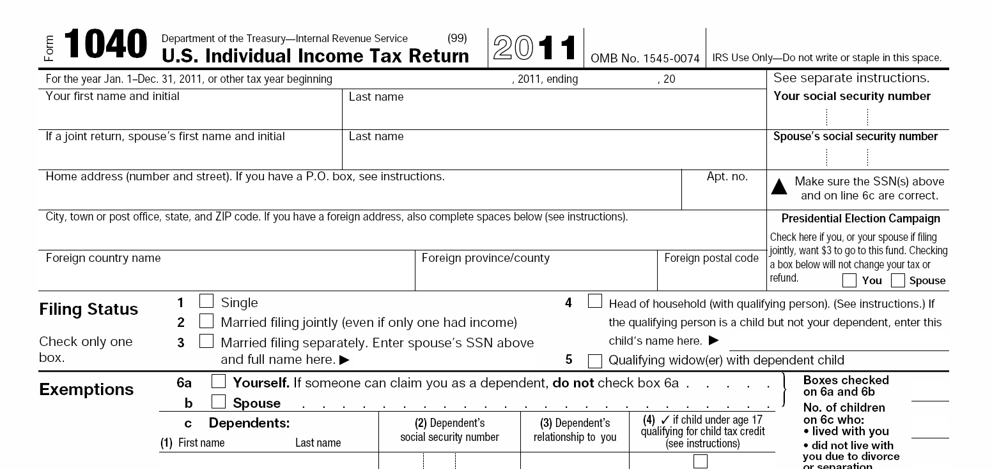
State & Federal Income Tax
Notes:
PDF of 1040 form http://www.irs.gov/pub/irs-pdf/f1040.pdf

Slide 43

Social Security
The Social Security tax is also called the FICA tax.
(Federal Insurance Contributions Act)
Social Security taxes provide the following benefits for employees and their dependents:
• retirement benefits
• benefits for the dependents of retired workers
• benefits for the disabled and their dependents

Slide 44
Medicare
The Medicare tax is used to provide medical benefits for certain individuals when they reach age 65. Workers, retired workers, and the spouses of workers and retired workers are eligible to receive Medicare benefits upon reaching age 65.
Notes:
Irs.gov

Slide 45

Other Taxes
Property tax
Sales tax
Gasoline tax
Local/City taxes

Slide 46
What is tax money used for?
Bridges
Road maintenance
Research
Education
Armed services, national defense, veterans, and foreign affairs
Retirement income for elderly
Social programs
Physical, human, and community development
Law enforcement
Interest on the national debt

Slide 47
Tax Forms
Federal Tax
  W-4
  I-9
  W-2
  1040EZ
Utah State Tax Form
  TC-40

Slide 48
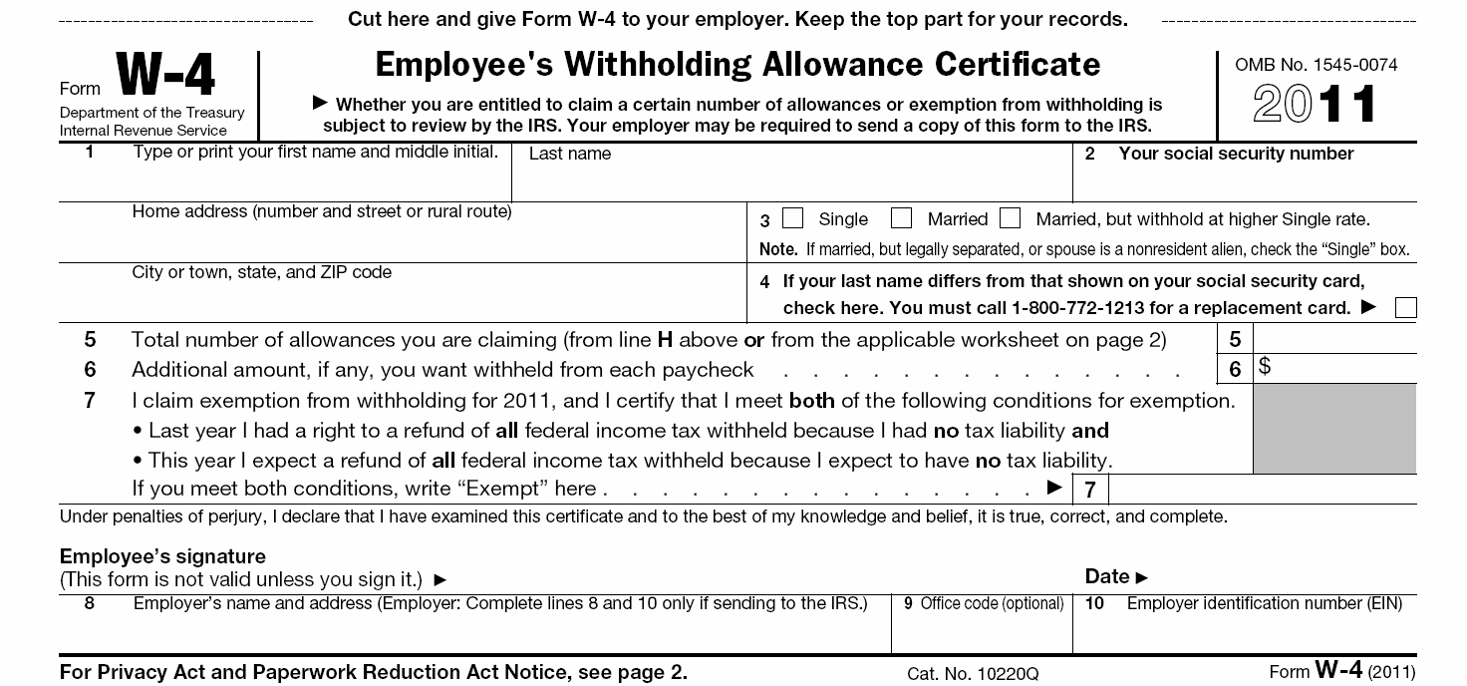
W4
You use W-4 Employee's Withholding Allowance Certificate Form to establish your withholding allowances for Federal income taxes.
Notes:
Complete Form W-4 so that your employer can withhold the correct federal income tax from your pay. Consider completing a new Form W-4 each year and when your personal or financial situation changes.
PDF of W-4 http://www.irs.gov/pub/irs-pdf/fw4.pdf

Slide 49
I9
An I-9 Form is the Employment Eligibility Verification Form required by the Immigration and Naturalization Services (INS) to verify your identity and your eligibility to work.
All employees must complete this form and provide valid original identifications.
You are not eligible for pay until Payroll Services receives a satisfactory I-9.

Slide 50
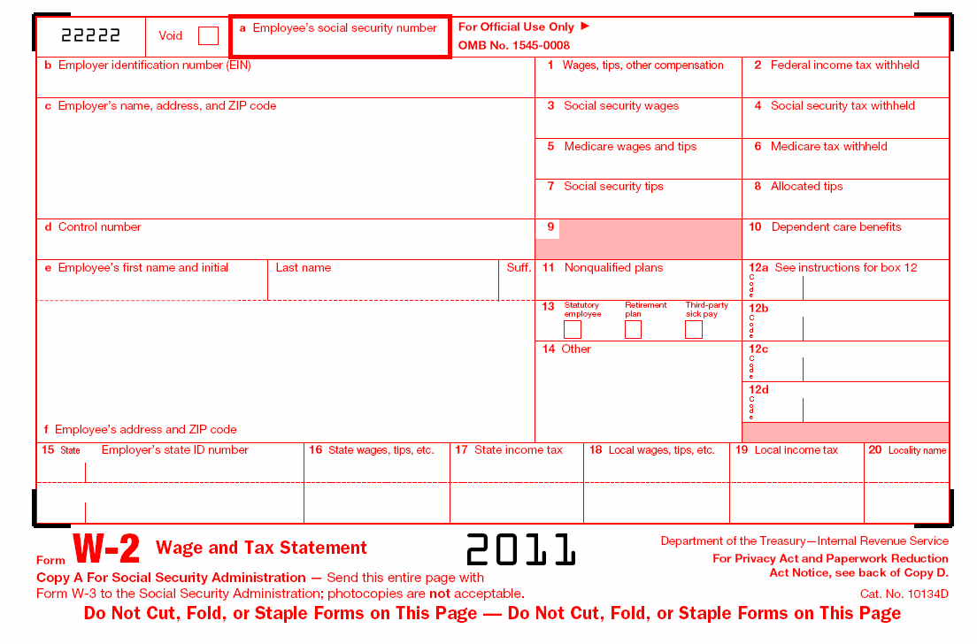
W-2
Form W-2 reflects all taxable wages you received during the calendar year and all taxes withheld from those wages.
The form serves as an annual report that enables you to file your personal income tax return with the Internal Revenue Service.
Notes:
PDF W2 http://www.irs.gov/pub/irs-pdf/fw2.pdf

Slide 51
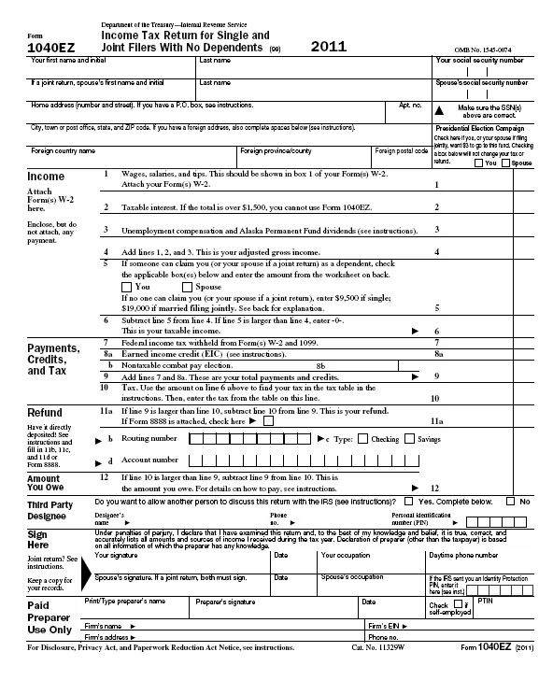
1040 EZ
Similar to the 1040 income tax form, 1040EZ is a faster and easier way to file your taxes. This form is only eligible for people with income less than $50,000 and interest income of $400 or less.
Notes:
PDF of 1040 EZ form http://www.irs.gov/pub/irs-pdf/f1040ez.pdf

Slide 52
Career Impact on Income

Slide 53
Earning Power
Earning power is the ability to earn money in exchange for work. How much you earn depends on the value of your skills in the marketplace.
An individual’s value as a worker – the wage or salary received for a specific job – is related to the skill level and education of the worker, the demand for that work in society, and the availability of qualified workers.

Slide 54
Earning Power
Generally, in our society, people with higher education and more skills earn more money on the job than those with less education and fewer skills.

Slide 55
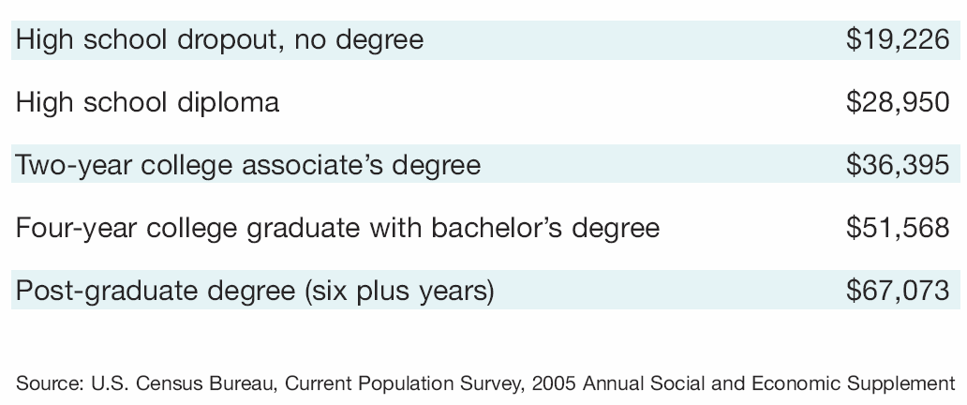
Value of Education
These figures show that for the average person, finishing high school is worth about $10,000 more (compared with dropping out). And finishing college nearly doubles the worth of that number to $22,000 more!
Notes:
http://hsfpp.nefe.org/loadFile.cfm?contentid=325 Student guide page 100

Slide 56

Entrepreneurship
Entrepreneur
  Willing to take risks
  A person who creates a business from scratch.
  Self employed
  Strong sense of discipline
  Be your own boss
  Beat the competition

Slide 57
Entrepreneurship
RISKS
  No guarantees
  No regular paycheck
  No boss
  Long hours
  Assume debt of business
REWARDS
  Be your own boss
  Keep profits
  Control
  Satisfaction
  Pursue talent and creativity

Slide 58
Spending Plans

Slide 59
What is a spending plan?
A tool used to record and track projected and actual income and expenses over a period of time.
Also called a budget.

Slide 60
Benefits of Spending Plans
A spending plan can help you:
Put aside money for savings goals
Prepare for regular expenses
Prepare for unexpected expenses
Control how you spend money
Reduce stress and increase confidence
Provide an excuse to calm excessive spending
Notes:
Reasons to budget are numerous:
To determine how much money you have to spend
To decide how you want to spend your money
To determine how to spend money in the future
To learn to live on less than available income
To stay out of financial trouble

Slide 61
Before creating a spending plan…
Track your spending.
  Before making a budget, spend a couple of weeks writing down every penny you spend.
  This will help you have a better idea of where your dollar amounts should be when making a budget.

Slide 62
How do I make a spending plan?
Assess your personal financial situation (needs, values, life situation).
Set personal and financial goals.
Create a budget for fixed and variable expenses based on projected income.
Monitor current spending (saving, investing) patterns.
Compare your budget to what you actually spent.
Review financial progress and revise budget amounts.
Notes:
Building a budget takes a little time. But it’s absolutely vital to financial health.
Track your expenses for a month to start a budget. What did you buy? What bills did you pay? Basically, where did your money go? Then categorize your spending into groups such as clothing, food, music downloads, auto, etc. Think of other areas in which you might spend money on a regular basis. Don’t forget to include some money for savings.
Identify your income. Only include regular sources of income such as paychecks and allowances. If you get paid monthly or semi-monthly, it is easy to calculate your monthly income. If you get paid weekly or biweekly, multiply your weekly income by 52 or 26 respectively to get your annual salary. Then divide by 12 to get your monthly income. Now that you have your expenses and income quantified, it’s time to examine and fine-tune your budget.
Subtract expenses from income. This is to determine how much money you have left over at the end of the month. If you have more income than expenses, that’s good. If you spend more money than you earn, you’re going to have to decrease your expenses or increase your income. Keep in mind it’s easier to decrease your expenses.
Timing is important. If you get paid once a month, be sure to budget money to last the whole month. If you get paid twice a month, but you have several large expenses at the beginning of the month, make sure you save some of your money from the end of the month to help with the next month’s bills.
Be prepared for new financial situations. When something changes, some part of your income or your expenses, you’ll know how it affects your overall financial picture, and what you need to do to cope with the changes.
Maintain your budget. Each month be sure to compare your actual spending with your budget. If you consistently spend more or less than your budgeted amount in any category, update your budget to reflect reality. An inaccurate budget can do more harm than good.
From PracticalMoneySkills.com

Slide 63
Checking Account & Debit Cards

Slide 64
What is a Checking Account?
Common financial service used by many consumers
Funds are easily accessed
  Check
  ATM (automated teller machine)
  Debit card
  Telephone
  Internet
Services and fees vary depending upon the financial institution

Slide 65
Why Do People Use Checking Accounts?
Reduces the need to carry large amounts of cash
Convenience – useful for paying bills
Spending Plan Tool
  Keeps a record of where money is spent
Safety – using checks is safer than carrying cash

Slide 66
What is a Check?
Used at the time of purchase as the form of payment
Piece of paper pre-printed with the account holder’s:
  Name
  Address
  Financial institution
  Identification numbers

Slide 67
Bouncing a Check
Check written for an amount over the current balance held in the account
  ‘Bounces’ due to insufficient funds, or not enough money in the account to cover the check written
A fee will be charged to the account holder
Harm future opportunities for credit

Slide 68
Other Checking Components
Checking Account Register
  Place to immediately record all monetary transactions for a checking account
    Written checks, ATM withdrawals, debit card purchases, deposits and additional bank fees
Checkbook
  Contains the checks and the register to track monetary transactions

Slide 69
ATM
Automated teller machine, or a cash machine
Can be used to withdraw cash and make deposits
Additional fees may be assessed if the ATM used is not provided by the financial institution sponsoring the card

Slide 70
Debit Card
Plastic card that looks like a credit card
Electronically connected to a bank account
Money is automatically taken from the bank account when purchases are made
Requires a PIN (personal identification number)
  Confirms the user is authorized to access the account

Slide 71
Pros and Cons - Debit Cards
Pros Cons
Convenient
Small
Can be used like a credit card
Allows a person to carry less cash
Does not allow overspending
Can lose track of balance if transactions are not written down
Opens checking account up to credit fraud
Others can gain access to the account if the card is lost and PIN is known

Slide 72
Banking Services & Credit
Financial Services, Credit Scores, Cost of Credit

Slide 73
Financial Institutions
Banks
Credit Unions
Investment brokers
Loan Agencies

Slide 74
Financial Institution Services
Checking Accounts
Debit Cards
Savings Accounts
Loans
Internet Banking
Online Bill Pay

Slide 75
Online Banking Services
Direct Deposit – earnings (or government payments) automatically deposited
into bank accounts, saving time, effort and money.
Automated Payments – utility companies, loan payments, and other businesses use an automatic payment system with bills paid through direct withdrawal from an account.

Slide 76
Online Banking Services
Automatic Teller Machines – allow customers to obtain cash and conduct banking transactions; some ATMs sell bus passes, postage stamps, gift certificates, and mutual funds.
Point of Sale Transactions – acceptance of ATM/check cards at retail stores and restaurants for payment of goods and services.
Stored Value Cards – Prepaid cards for telephone service, transit fares, highway tolls, laundry service, library fee, and school lunches.

Slide 77
Online Banking Services
Electronic Cash – companies are developing electronic replicas of all existing payment systems – cash, check, credit cards, and coins.
Cyberbanking – banking through online services. Financial institutions with Web site “cyber” branches allow customers to check balances, pay bills, transfer funds, compare savings plans, and apply for loans on the Internet.

Slide 78
Online Banking Services
Smart Cards – are sometimes called “electronic wallets”, and look like ATM
cards; however, they also include a microchip. This minicomputer stores prepaid amounts for buying goods and services. It can also store data about a person’s account balances, transaction records, insurance information, and medical history.

Slide 79
Credit Rating
A measure of a person’s ability and willingness to make credit payments on time.

Slide 80
Three C’s of Credit
Capital
Character
Capacity
Personal items of value
The ability to be trusted
The ability to repay a loan

Slide 81
Info Found on Credit Report
A Consumer Credit Report (CCR) details, in depth information about your credit history, and will also include:
    Your full name
    Any alias’s that you have used
    Social Security Number
    Current address
    Previous addresses
Your credit report may also contain:
Your phone number
Age/date of birth
Your employer’s details
Notes:
81
It’s hard to imagine functioning in today’s society without access to credit. America’s average credit card debt is $9,000. Many individuals fall victim to some of the pitfalls associated with credit cards.
Teaser Rates - credit card companies will typically offer low introductory interest rates to attract new customers, but these rates typically last for only a few months and then jump as high as 20%.
Cash Rewards - Department stores always try and offer you their own credit cards. Some of these cards have deals like cash rewards after spending a certain amount or store discounts, but they typically have high interest rates, making the deals not worth it in the end.
So, how do you not fall victim to credit card pitfalls? You are here tonight to obtain financial education, which gives you power to make wise decisions.

Slide 82
Info NOT Found on Credit Report
Race
Color
Sex
National origin
Marital status
Political persuasion
Medical Bill Details (Lender Reports)
Notes:
82
It’s hard to imagine functioning in today’s society without access to credit. America’s average credit card debt is $9,000. Many individuals fall victim to some of the pitfalls associated with credit cards.
Teaser Rates - credit card companies will typically offer low introductory interest rates to attract new customers, but these rates typically last for only a few months and then jump as high as 20%.
Cash Rewards - Department stores always try and offer you their own credit cards. Some of these cards have deals like cash rewards after spending a certain amount or store discounts, but they typically have high interest rates, making the deals not worth it in the end.
So, how do you not fall victim to credit card pitfalls? You are here tonight to obtain financial education, which gives you power to make wise decisions.

Slide 83
What is a Credit Score?
(FICO)
Snapshot of a person's financial standing at a particular point in time
The one most widely used is the "FICO" score (Fair Isaac Corporation)
The FICO score, a three-digit number
between 300 and 850
Notes:
83
Image: http://www.myfico.com/HelpCenter/FICOScores/

Slide 84
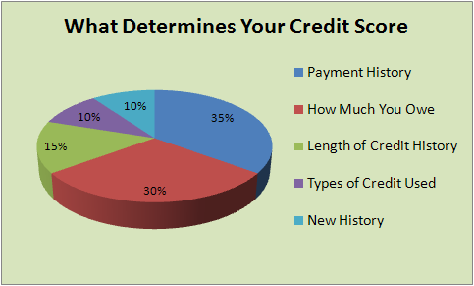

Slide 85
Benefits of Using Credit

Slide 86
Convenience of Purchase
Buying on credit can be more convenient than using cash. Using credit makes the initial purchase very easy.

Slide 87
Less Risk of Losing Cash at the Time of Purchase
When using cash, you have to worry about someone stealing it. One who loses a credit card has a limited or no liability for unauthorized charges if the card company is notified.

Slide 88
Strategies for maintaining positive credit include:
Practicing good banking techniques, such as not bouncing checks
Paying bills on time and consistently
Avoiding bankruptcy
Not having a criminal record
Having a low number of credit/store cards
Removing errors from credit report
Maintaining reasonable amounts of unused credit

Slide 89
Credit Reporting Agencies
EquiFax
  1.800.685.1111 www.equifax.com
Experian
  1.888.397.3742 www.experian.com
TransUnion
  1.800.860.7289 www.transunion.com
www.annualcreditreport.com

Slide 90
Good Debt vs. Bad Debt
GOOD
A reasonable Mortgage Loan
A reasonable Auto Loan
Student Loans
Business Loans
Small Credit Load
These “GOOD” debts may be needed, but you can over-leverage yourself. In that case, it could be considered a bad debt.

Slide 91
Who Looks at Your Credit?
Lenders
  Credit Cards
  Store Cards
  Auto Loans
  Mortgages
  Personal Loans
  Furniture Loans
  Computer Loans
Utility Companies
Cell Phone Companies
Insurance Carrier
Employers
Military (Security Clearance)
Rental agents
Bank
  (checking/savings accts)

Slide 92
Which Accounts Build Credit?
YES
  Credit Cards
  Store Cards
  Auto Loans
  Mortgages
  Personal Loans
  Furniture Loans
  Computer Loans
NO
  Checking/Savings Accts
  Cell Phone
  Utilities
  Insurance
  Rental Agents (Housing)
  Employers
  Payday Loans
  Title Loan Companies

Slide 93
Credit Scores Affect
Financial Options
HIGH SCORES
  Low interest rate on loans
  Ability to receive loans/credit
  Reflects borrower is a low risk to lender
  Ability to acquire conveniences such as cell phones and credit cards
LOW SCORES
  High interest rate on loans
  Inability to receive loans/credit
  Reflects borrower is high risk for lenders
  Inability to acquire conveniences

Slide 94
How do I build credit if I have never had it?
Open a line of Credit: Credit Card
  Buy things you would normally buy, pay off at the end of each month
  If you don’t qualify, consider a secured card
  Take caution when asking for a co-signer
  Buy things you would normally buy during the month
  Pay the account off in full at the end of each month

Slide 95
Bankruptcy
Notes:
All you would ever need on bankruptcy: http://www.uscourts.gov/Viewer.aspx?doc=/uscourts/FederalCourts/BankruptcyResources/bankbasics.pdf

Slide 96
Bankruptcy
A legal process to get out of debt when you can no longer make all your required payment.

Slide 97
Reasons for Bankruptcy
Natural Disaster
Medical Expenses
Job Loss
Business Losses
Credit Card Debt

Slide 98
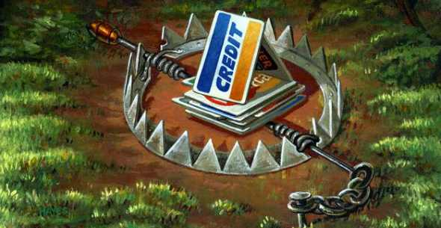
Debt
The entire amount of money a person owes to lenders.

Slide 99
Inflation
An increase in the price of goods and services. A dollar in the future won’t buy as much as a dollar today.
  Did you know…
    Inflation usually averages between 3% and 4% each year.
    Inflation has influenced our economy for decades ranging from .5% to 18%.
    In 1971 a first class stamp cost 8 cents.

Slide 100
Bankruptcy Basics
Chapter 7
  LIQUIDATION
    wipes out all allowable debts and allows certain personal property exemptions.
Chapter 13
  REORGANIZATON
    is a court-approved repayment plan.

Slide 101
Alternatives to Bankruptcy
Out of court settlement
Reduction of payments
Attaining help from consumer credit counseling
Payment of debts by selling or borrowing on property.
Notes:
All you would ever need on bankruptcy: http://www.uscourts.gov/Viewer.aspx?doc=/uscourts/FederalCourts/BankruptcyResources/bankbasics.pdf

Slide 102
Things to Consider BEFORE Filing
A bankruptcy filing could determine whether or not you get a job.
Your insurance rates could rise.
You may find it difficult to rent an apartment or qualify for a home loan.
Bankruptcies stay on your credit report for 10 years.
Bankruptcy can lower your credit score.
102
Notes:
Stimulate group discussion by asking the following questions:
• Why would someone declare bankruptcy?
• Are there legitimate reasons to declare bankruptcy?
Listen to the responses. Do not pass judgment on responses. This exercise
is simply to get participants thinking about situations in which an individual
might declare bankruptcy.
Stress that while there are legitimate reasons to declare bankruptcy, it should always be a last resort.
Debrief participants by showing “Slide 3: Things to Consider before
Filing for Bankruptcy” and reviewing each point on the slide.

Slide 103
Savings vs. Investing

Slide 104
Savings
Savings is the portion of current income not spent on consumption.
Investments
Investing is the purchase of assets with the goal of increasing future income.

Slide 105
Risk, Return, and Liquidity
Risk
  The chance that the value of an investment will decrease.
Return
  The profit or yield from an investment.
Liquidity
  The ability of an investment to be converted into cash quickly without loss of value.

Slide 106
Risk, Return, and Liquidity
Savings
  Low risk
  Low return
  High liquidity
Investments
  High risk
  High return
  Low liquidity

Slide 107
Time Value of Money
The time value of money refers to the fact that a dollar in hand today is worth more than a dollar promised at some future time.

Slide 108

Future Value
Refers to the amount of money to which an investment will grow over a finite period of time at a given interest rate.
Put another way, future value is the cash value of an investment at a particular time in the future.

Slide 109

Types of Investments

Slide 110
Types of Investments
Stocks
Bonds
Mutual Funds
Real Estate
Savings/Certificates of Deposit
Collectibles

Slide 111
Stocks
An investment that represents ownership in a company or corporation.

Slide 112
How Well the Stock Market is Doing Overall

Slide 113
3 Basic Indicators
Dow Jones Industrial Average (“DOW”)
  Lists the 30 leading industrial blue chip stocks
Standard and Poor’s 500 Composite Index
  Covers market activity for 500 stocks
  More accurate than DOW because it evaluates a greater variety of stock
National Association of Security Dealers Automated Quotations (“NASDAQ”)
  Monitors fast moving technology companies
  Speculative stocks, show dramatic ups and downs

Slide 114

Ups and Downs
The term bull market means the market is doing well because investors are optimistic about the economy and are purchasing stocks
The term bear market means the market is doing poorly and investors are not purchasing stocks or selling stocks already owned

Slide 115
Brokers
A Broker is a person who is licensed to buy and sell stocks, provide investment advice, and collect a commission on each purchase or sale
  Purchases stocks on an organized exchange (stock market)
  Over ¾ of all stocks are bought and sold on an organized exchange

Slide 116
New York Stock Exchange
New York Stock Exchange (NYSE)
  Oldest and largest, began in 1792
  1,366 seats available
  2,800 companies
  Average stock price is $33.00
  Strict requirements

Slide 117
American Stock Exchange
American Stock Exchange
  Began in 1849
  2nd largest exchange
  It’s requirements are not as strict as NYSE allowing younger, smaller companies to list
  Average stock price is $24.00

Slide 118
NASDAQ
National Association of Securities Dealers Automated Quotations
  Stocks are traded in an over the counter electronic market
  4,000 small companies
    Company requirements are not as strict
  More volatile because companies are young and new
  Average stock price is $11.00

Slide 119
Bonds
A security representing a loan of money from a lender to a borrower for a set time period, which pays a fixed rate of interest.
Notes:
Bonds
When you invest in a bond, you effectively lend your money to an organization.
When a bond is issued, it includes a specified maturity date at which
time the principal will be repaid. Bonds are also issued at a particular interest
rate, or what’s known as a coupon. This rate is fixed on most bonds. So,
for example, if you buy a five-year, 6-percent bond issued by Home Depot,
you’re lending your money to Home Depot for five years at an interest rate of
6 percent per year. (Bond interest is usually paid in two equal, semi-annual
installments.)
The value of a bond generally moves opposite of the directional change in
interest rates. For example, if you’re holding a bond issued at 6 percent and
rates increase to 8 percent on comparable, newly issued bonds, your bond
decreases in value. (Why would anyone want to buy your bond at the price
you paid if it yields just 6 percent and 8 percent can be obtained elsewhere?)
Some bonds are tied to variable interest rates. For example, you can buy bonds
that are adjustable-rate mortgages, on which the interest rate can fluctuate.
As an investor, you’re actually lending your money to a mortgage borrower —
indirectly, you’re the banker making a loan to someone buying a home.
Bonds differ from one another in the following major ways:
✓ The type of institution to which you’re lending your money: With
municipal bonds, you lend your money to the state or local government
or agency; with Treasuries, you lend your money to the federal government;
with GNMAs (Ginnie Maes), you lend your money to a mortgage
holder (and the federal government backs the bond); with corporate
bonds, you lend your money to a corporation.
✓ The credit quality of the borrower to whom you lend your money:
This refers to the probability that the borrower will pay you the interest
and return your principal as agreed.
✓ The length of maturity of the bond: Short-term bonds mature within a
few years, intermediate bonds within 3 to 10 years, and long-term bonds
within 30 years. Longer-term bonds generally pay higher yields but
fluctuate more with changes in interest rates.
Bonds are rated by major credit-rating agencies for their safety, usually on a
scale where AAA is the highest possible rating. For example, high-grade corporate
bonds (AAA or AA) are considered the safest (that is, most likely to pay
you back). Next in safety are general bonds (A or BBB), which are still safe but
just a little less so. Junk bonds (rated BB or lower), are actually not all that
junky; they’re just lower in quality and have a slight (1 or 2 percent) probability
of default over long periods of time.
Some bonds are callable, which means that the bond’s issuer can decide to pay
you back earlier than the previously agreed-upon date. This event usually occurs
when interest rates fall and the lender wants to issue new, lower-interest-rate
bonds to replace the higher-rate bonds outstanding. To compensate you for
early repayment, the lender typically gives you a small premium over what
the bond is currently valued at.
Personal Finance for Dummies

Slide 120
Mutual Funds
An investment that pools money from several investors to buy a particular type of investment, such as stocks.
Notes:
Mutual Funds A fund managed by a company that includes a portfolio of stocks or bonds
Risk varies depending on type of mutual fund
PROS
- Diversified
You can select different risk levels
CONS
- Return isn’t guaranteed
- Can be subject to expensive management fees

Slide 121
Real Estate
An investor buys pieces of property, such as land or a building, in hopes of generating a profit.
Notes:
Real Estate
Over the generations, real estate owners and investors have enjoyed rates of return comparable to those produced by the stock market, thus making real estate another time-tested method for building wealth. However, like stocks, real estate goes through good and bad performance periods. Most people who make money investing in real estate do so because they invest over many years and do their homework when they buy to ensure that they purchase good property at an attractive price.
Buying your own home is the best place to start investing in real estate. The equity (the difference between the market value of the home and the loan owed on it) in your home that builds over the years can become a significant part of your net worth. Among other things, this equity can be tapped to help finance other important money and personal goals, such as retirement, college, and starting or buying a business. Moreover, throughout your adult life, owning a home should be less expensive than renting a comparable home.
When you want to invest directly in real estate, residential housing — such as single-family homes or small multi-unit buildings — may be an attractive investment. Buying properties close to home offers the advantage of allowing you to more easily monitor and manage what’s going on. The downside is that you’ll be less diversified — more of your investments will be dependent on the local economy.
If you don’t want to be a landlord — one of the biggest drawbacks of investment real estate — consider investing in real estate through real estate investment trusts (REITs). REITs are diversified real estate investment companies that purchase and manage rental real estate for investors. A typical REIT invests in different types of property, such as shopping centers, apartments, and other rental buildings. You can invest in REITs either by purchasing them directly on the major stock exchanges or by investing in a real estate mutual fund that invests in numerous REITs.
Personal Finance for Dummies

Slide 122
Savings/Certificates of Deposits
A deposit that earns a fixed interest rate for a specified length of time.
  The longer the time period the greater the rate of return.
  There is a substantial penalty for early withdrawal.
Notes:
A bank is one of the safest places to stash your cash. In the wake of the financial crisis of 2008, the federal government increased the level of insurance on bank accounts -- it's now $250,000 per depositor.
Banks pay lower rates on interest-bearing accounts than brokerages and mutual fund companies that offer check-writing privileges. What's more, bank fees can be high -- account costs can easily add up to $200 a year or more unless you keep a minimum required balance on deposit.
Even at a low rate of inflation, the annual creep in the cost of goods and services usually outpaces what banks pay in interest-bearing accounts.
Certificates of deposit (CDs) offer some of the best guaranteed rates on your money and are insured up to $250,000 each.
The catch: you have to lock up your money for three months to five years or more. If interest rates fall before the CD expires, the bank is out of luck and must give you the rate it quoted. If rates climb, you're stuck with the lower rate.
Also with rising interest rates, money market accounts can become an attractive option, too. They pay more than banking accounts and you don't have to lock up your money for a specific amount of time.

Slide 123
Collectibles
Unique items that are relatively rare or highly valued.
  Art work
  Baseball trading cards
  Coins
  Automobiles
  Antiques
Notes:
Collectibles
The collectibles category is a catchall for antiques, art, autographs, baseball cards, clocks, coins, comic books, diamonds, dolls, gems, photographs, rare books, rugs, stamps, vintage wine, and writing utensils — in other words, any material object that, through some kind of human manipulation, has become more valuable to certain humans.
Notwithstanding the few people who discover on the Antiques Roadshow that they own an antique of significant value, collectibles are generally lousy investment vehicles. Dealer markups are enormous, maintenance and protection costs are draining, research is time-consuming, and people’s tastes are quite fickle. All this for returns that, after you factor in the huge markups, rarely keep up with inflation. Furthermore, investment gains you do earn on collectibles are taxed at a higher federal tax rate (28 percent) than capital gains on stocks, real estate, and small business (15 percent).
Buy collectibles for your love of the object, not for financial gain. Treat collecting as a hobby, not as an investment. When buying a collectible, try to avoid the big markups by cutting out the middlemen. Buy directly from the artist or producer if you can.
Personal Finance for Dummies

Slide 124
Identity Theft & Consumer Protection

Slide 125
Consumer Rights & Responsibilities
RIGHTS | RESPONSIBILITIES
To Safety | To Use Products Safely
To Be Informed | To Seek Information and Use it to make Decisions
To Choose | To Choose Goods and Services Carefully
To Be Heard | To Speak Up and Let Likes and Dislikes Be Known
Consumer Bill of Rights (State of the Union Address of 1962, President John F. Kennedy) Source: Thomson South-Western, Economic Education for Consumers; USOE Adult Roles & Responsibilities

Slide 126
Agencies & Sources of Assistance
Food & Drug Administration (FDA) | www.fda.gov
Consumer Product Safety Commission (CPSC) | www.cpsc.gov
Federal Trade Commission (FTC) | www.ftc.gov
Better Business Bureau (BBB) | www.bbb.org
Bureau of Consumer Protection (BCP) | www.ftc.gov
Consumer Unions (Consumer Product-Testing Organizations) | Consumer Report Consumer Research Changing Times
Source: USOE Adult Roles & Responsibilities Curriculum

Slide 127
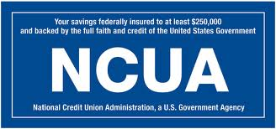
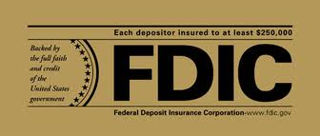
Who Protects Savers?
Credit Unions
Banks
Notes:
FDIC- Federal Depository Insurance Corporation
-Insures funds in a federally chartered bank up to $250,000 per account.
-Created in 1933 to maintain public confidence and stability
NCUA- National Credit Union Association
-Insures funds in a credit union up to $250,000 per account.

Slide 128
Fraud
A deliberate deception, designed to secure unfair or unlawful gain.
  (“Cheating the Consumer”)

Slide 129
Identity Theft
“True-name Fraud”
Someone wrongfully acquires and uses a consumer’s personal identification, credit, or account information without your permission.
This information may include:
  Social Security Numbers
  Name
  Address
  Date of Birth
  Mother’s Maiden Name
  Passwords
  PINs

Slide 130
Ways to Avoid Identity Theft
Monitor your credit report.
Don’t give out personal information to unknown people or companies.
Protect your credit and debit cards.
Protect your mailbox.
Protect your wallet.
Use passwords and PINs that cannot be easily guessed.
Use anti-virus software on your computer.
Notify your bank when you change your address or phone number.

Slide 131
Insurance & Risk Management
Notes:
100 40

Slide 132
Risk Management
“In exchange for a relatively small payment, which is the premium, you’re protected against the chance of a big financial setback, a large loss.”

Slide 133
Risk Management
Means you use various ways to deal with potential personal or financial losses.

Slide 134
Insurance
Protection against large-scale financial loss

Slide 135
Insurance Premium
The payment you make to an insurance company in exchange for its promise of protection and help.
Can be monthly, quarterly, semi-annually, or annually.

Slide 136
Deductible
The amount of the loss you must pay out of your own pocket before the insurance company begins to reimburse you.
Range from $100-$1,000+
SHOP AROUND for best rates

Slide 137
Automobile
Health
Types of
Insurance
Disability
Life
Homeowners/Renters

Slide 138
Auto Insurance
Liability Coverage
Medical Payments
Uninsured Motorist
Underinsured Motorist
Collision

Slide 139
Auto Policies
The following factors can influence the cost of the policy.
Age
Gender
Marital Status
Type of Car
Cost of Repairs
Mileage
Location
Law Enforcement
Driving Record

Slide 140
Health Insurance
Pays the medical bills in case you or your family members, become sick or injured.
Most will cover you until age 19. If you are in college, they may extend until 23.

Slide 141
Property Insurance
Protects your material possessions in case they are damaged by fire, flood, or theft.
Homeowner’s insurance vs Renter’s Insurance
Notes:
Similarities in Rental and Homeowner Insurance
Both rental and homeowner insurance provide protection for you and your property. Both insurances are designed to help you replace lost personal property as a result of fire or water damage and vandalism and theft. In addition, both rental and homeowner insurance can provide you with liability protection in case someone is injured while at your home. However, if someone is injured while at your rental property, the landlord may be liable regardless of the cause of the injury.
Differences in Rental and Homeowner Coverage
The biggest difference between rental and homeowner insurance is the dwelling coverage. When you own the home, you need insurance to cover the cost of replacing your home if it is lost in a fire, repairing the home if it is damaged by vandalism, fire, or water, and protecting you from other structural concerns (like a tree falling on the roof and caving it in).
When you are a renter, you need to insure yourself against damage you might cause to the structure. For example, if you have a waterbed and it breaks and damages the flooring, your insurance could cover that if it is included in your policy. However, if there was massive rain that caused flooding, your landlord's insurance policy would cover the damage. It would not be your responsibility.
Your renter's policy should focus more on replacing your personal property that might be stolen, damaged, or lost in a fire or flood. Your landlord's policy is responsible for injuries that happen on the premises and damage to the property itself.
http://www.finweb.com/insurance/rental-vs-homeowners-insurance.html

Slide 142
Life Insurance
Anytime someone else depends on your income to help pay bills, you need life insurance.
Protects people who depend on you financially in the event of your untimely death.
Term Life vs Whole Life
Notes:
Term life insurance is the purest form of coverage. It is purchased for a period of time, or term, and when that period of time expires, the life insurance ends. It is common to buy a term policy for 10 to 30 years, though different periods are available. So if you die you win (so to speak). If you live past the length of the policy, you (or, more specifically, your family members) get no money back. Because the policies are temporary, and only cover death benefits only, a term policy is usually the cheapest life insurance to buy, and is the choice of most younger families.
Whole (or permanent) life insurance, on the other hand, is designed to cover a person for their whole life. It builds a cash value or “savings account”, and so is a combination of life insurance and savings. As long as the policy is paid for, or paid up, the coverage will be in force. Because of this, whole life insurance is more expensive. If you live, you get back at least some of, and often much more than, the amount you spent on your premium. You get this money back either by cashing in the policy or by borrowing against it
The key is how long you plan to keep the policy. Most financial advisors will tell their clients, especially younger clients, to purchase term coverage. They do this because term policies are much cheaper, and the extra money can be used for other investments that may provide better returns than whole life policies. In most cases, this is probably good advice, especially for large amounts of coverage that growing families need.
http://www.savingtoinvest.com/2009/03/life-insurance-whole-versus-term-and.html

Slide 143
Future Insurance Needs
Health Insurance
Property Insurance
Life Insurance
Disability Insurance
Liability Insurance

Slide 144
Estate Planning
Estate planning is preparing a plan for transferring property during one’s lifetime and at one’s death.
Goal should be to minimize taxes on the estate, make known how you want your possessions distributed, and to provide for a smooth transfer of your possessions to loved ones after death.

Slide 145
Tools for Estate Planning
Will
Trust
Joint Ownership of Assets

Slide 146
Will
A legal document that tells how you want your estate to be distributed after your death.

Slide 147
Power of Attorney
A legal instrument authorizing one to act as another’s attorney or agent.

Slide 148
Trust
A legal document in which an individual gives someone else control of property, for ultimate distribution to another person.

Slide 149

Retirement Planning

Slide 150
Sources of retirement income:
Pension plans
  401(k), 403(b)
  Traditional IRA
  Roth IRA
  Keogh plan
  Social Security
Notes:
Keogh Plan- A tax deferred pension plan available to self-employed individuals or unincorporated businesses for retirement purposes. A Keogh plan can be set up as either a defined-benefit or defined-contribution plan, although most plans are defined contribution. Contributions are generally tax deductible up to 25% of annual income with a limit of $47,000 (as of 2007). Keogh plan types include money-purchase plans (used by high-income earners), defined-benefit plans (which have high annual minimums) and profit-sharing plans (which offer annual flexibility based on profits).

Slide 151
Planning for retirement is your responsibility!
Traditional employer-funded retirement plans are disappearing.
Social Security benefits may not insure a comfortable lifestyle.
Without a retirement plan, you could face a future of financial uncertainties and hardships.

Slide 152
Compound Interest
Interest which is calculated not only on the initial principal, but also the accumulated interest of prior periods.

Slide 153
Rule of 72
Tells you how long it takes your money to double in value.
Divide 72 by the interest rate to determine number of years to double.
Divide 72 by years to determine rate needed to double your money in a given time period.

